Slide 1
Binary Tree
Parinya Sanguansat

Slide 2
Tree
Tree = Node + Edge
Each node has only one parent
Root node has no parent
Each parent can handle many child nodes
#Edge = #node - 1

Slide 3
Implement tree with array
Use array for each node
Use maximum number of child nodes for the length of all arrays
20
15
10
20
9
7
2
3
15
10
9
7
2
3

Slide 4
Implement with link list
A Link from parent to first child
A Link from child to next child of same parent
20
15
10
20
9
7
2
3
15
10
9
7
2
3

Slide 5
Binary Tree
Parent links to both children
public class Node
{
public object e;
public Node left, right;
public Node(object e, Node left, Node right)
{
this.e = e;
this.left = left;
this.right = right;
}
public bool isLeaf()
{ return left == null && right == null; }
}
20
15
10
9
7
2
3
20
15
10
9
7
2
3

Slide 6
Binary Tree Class
numNodes: return the number of all nodes
depth: return the depth of tree
public class BinaryTree
{
public class Node{}
protected Node root;
public int numNodes(){}
public int depth(){}
private int numNodes(Node node){}
private int depth(Node node){}
}

Slide 7
BinaryTree: numNodes
public int numNodes()
public int numNodes()
{
return numNodes(root);
}
recursive
0
Binary Tree
1+numNodes(left)+numNodes(right)
=
Binary Tree
Binary Tree
left
right
private int numNodes(Node node)
{
if (node == null) return 0;
return 1 + numNodes(node.left) + numNodes(node.right);
}

Slide 8
BinaryTree: depth
public int depth()
public int depth()
{
return depth(root);
}
recursive
-1
Binary Tree
1+max{depth(left),depth(right)}
=
Binary Tree
Binary Tree
left
right
private int depth(Node node)
{
if (node == null) return -1;
return 1 + Math.Max(depth(node.left), depth(node.right));
}

Slide 9
Tree Traversal
Visit all nodes once
Preorder ABDECFHG
Inorder DBEAHFCG
Postorder DEBHFGCA
A
B
C
D
E
F
G
H

Slide 10
Expression
Preorder => Prefix +*23/62
Inorder => Infix 2*3+6/2
Postorder => Postfix 23*62/+
+
*
/
2
3
6
2

Slide 11
BinaryTree: toArray
public object[] toArray()
public object[] toArray()
{
int n = numNodes(root);
object[] a = new object[n];
toArrayPreorder(root, a, 0);
return a;
}
A
B
C
private int toArrayPreorder(Node x, object[] a, int k)
{
if (x == null) return k;
a[k++] = x.e;
k = toArrayPreorder(x.left, a, k);
k = toArrayPreorder(x.right, a, k);
return k;
}
ABC
Inorder?
Postorder?

Slide 12
Huffman Code
Parinya Sanguansat

Slide 13
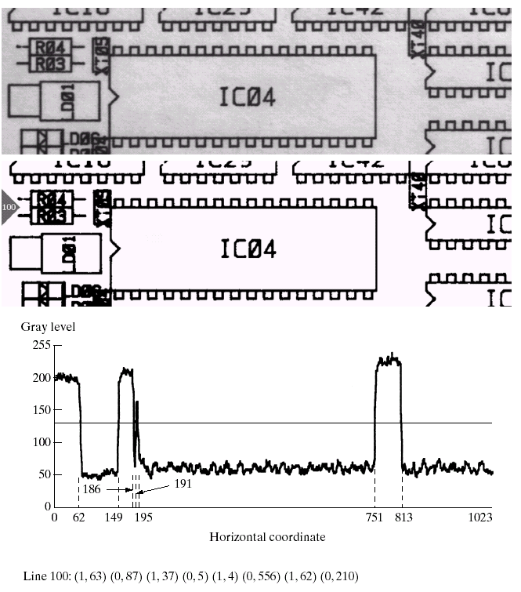
Why we need Huffman Code?
For data compression
We have a limited storage
We need the fast transmission
Example
1024 bits → 88 bits
R_{D} = 0.62

Slide 14
Measuring Information
The self-information of a random event that occurs with probability is defined as
bit
If (always occur)
Then bit (no information)
If (Ex: flipping a coin)
Then bit

Slide 15
Entropy
Entropy or uncertainty
The average information per source output
Information ∝ entropy
If the source symbols are equally probable
The entropy is maximized
The source provides the greatest possible average information per source symbol

Slide 16
Huffman Code
The smallest possible number of code symbols per source
When coding the symbols of an information source individually
The resulting code is optimal for a fixed value of n, subject to the constraint that the source symbols be coded one at a time.

Slide 17
Huffman Coding
Source reduction and Code assignment
A | 0.4 | 1 | 0.4 | 1 | 0.4 | 1 | 0.4 | 1 | 0.6 | 0
B | 0.3 | 01 | 0.3 | 01 | 0.3 | 01 | 0.3 | 00 | 0.4 | 1
C | 0.1 | 001 | 0.1 | 001 | 0.2 | 000 | 0.3 | 01
D | 0.1 | 0001 | 0.1 | 0000 | 0.1 | 001
E | 0.06 | 00000 | 0.1 | 0001
F | 0.04 | 00001
L_{avg} = 0.4(1)+0.3(2)+0.1(3)+0.1(4)+0.06(5)+0.04(5)
= 2.2 bits/symbol
Entropy
= 2.14 bits/symbol
Huffman code efficiency = 2.14/2.2 = 0.973

Slide 18
Huffman Tree
Represent code by tree
100
1
0
40
60
A
1
0
30
30
B
1
0
10
20
C
1
0
10
10
D
1
0
4
6
E
F

Slide 19
HuffmanTree class
Inherit from BinaryTree and use BinaryMinHeap
public class HuffmanTree : BinaryTree, IComparable
{
public HuffmanTree(int f, Node left, Node right)
{ root = new Node(f, left, right); }
public int CompareTo(object x)
{ return Frequency() - ((HuffmanTree)x).Frequency(); }
public int Frequency()
{ return (int)root.e; }
public static HuffmanTree encode(int[] f)
{
BinaryMinHeap h = new BinaryMinHeap(0);
for (int i = 0; i < f.Length; i++)
h.enqueue(new HuffmanTree(f[i], null, null));
for (int i = 0; i < f.Length - 1; i++)
{
HuffmanTree t1 = (HuffmanTree)h.dequeue();
HuffmanTree t2 = (HuffmanTree)h.dequeue();
int sumf = t1.Frequency() + t2.Frequency();
h.enqueue(new HuffmanTree(sumf, t1.root, t2.root));
}
return (HuffmanTree)h.dequeue();
}
}

Slide 20
Class work 1: Binary Tree
Rewrite toArray method for supporting all traversal: preorder, inorder, and postorder
Use static class and const field for options
Export HuffmanTree to array

